Slide 1
It's We, not Me: Building on the Social Nature of Human Consciousness
Steven C. Hayes
University of Nevada

Slide 2
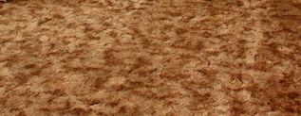
The 33 Year Old Man
Sitting on the Shag Carpet

Slide 3

What is a Human Mind?
In Each Case
I Will Argue the
Answer Pivots on
WE, not ME
Why is Being Human So Hard?
What Can Be Done About It?

Slide 4

People are Evolving Systems. A Science of Change Depends on It.

Slide 5

Variation

Slide 6

Fitted to Context

Slide 7

Selected

Slide 8
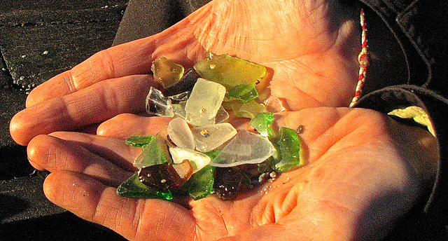
And Retained

Slide 9

Enemies of Variation: Avoidance

Slide 10

Enemies of Healthy Variation:
Excessive Rule Following

Slide 11
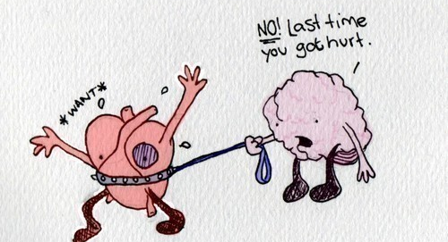
These are Linked: Our Minds Puts Our Hearts on a Leash

Slide 12
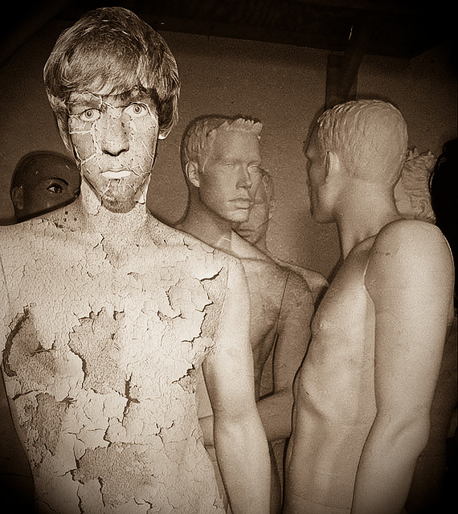
ME
MINDS TELL US WHO WE ARE
Notes:
We try to be the cartoon our narratives make of ourselves

Slide 13
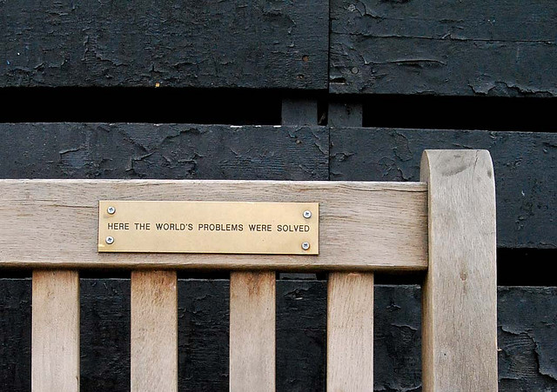
And Provide the Agenda

Slide 14
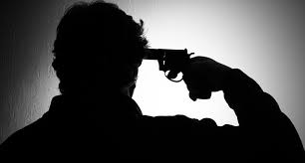
Feel Good or Else

Slide 15
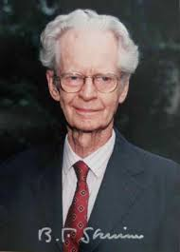
Contingency
Learning Drives Development.
It is Half a
Billion Years Old
Notes:
what is the purpose of scientific analysis?
how do we know we have learned something?
what kinds of concepts and methods are needed?

Slide 16
It is the Conflict Between that and Something that
Happened Far
More Recently
Notes:
Do a hexaflexifility

Slide 17
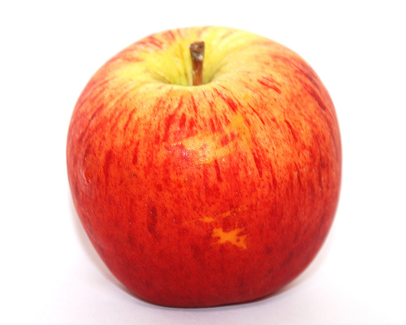
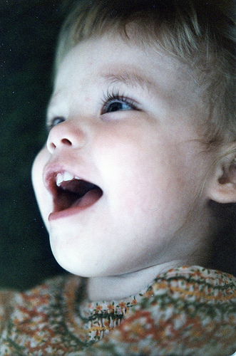
“Apple”
Object → sign

Slide 18
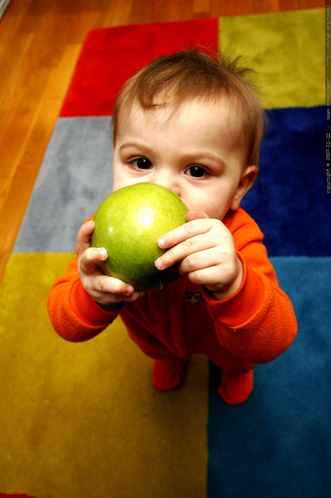
“Where’s the Apple?”
This is Derived
Yields sign → object

Slide 19
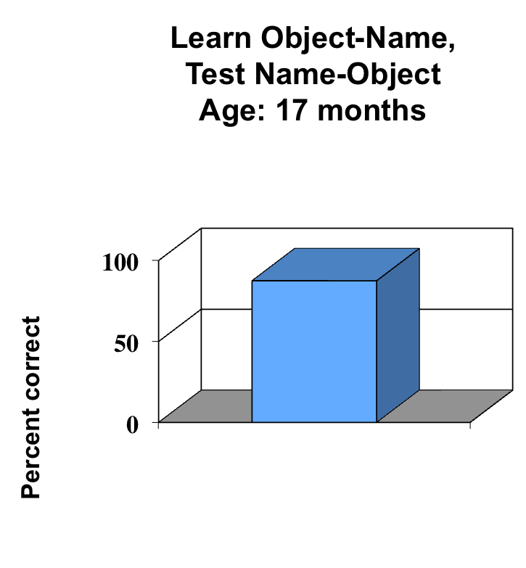
Human Infants Do
This Readily
Notes:
What was the BA strategy: get clear on philosophy, get clear on the psychological level of analysis, create a foundation of basic principles about
organism environment interactions at the individual psychological level, conduct functional analyses of complex human behavior, create applied programs

Slide 20
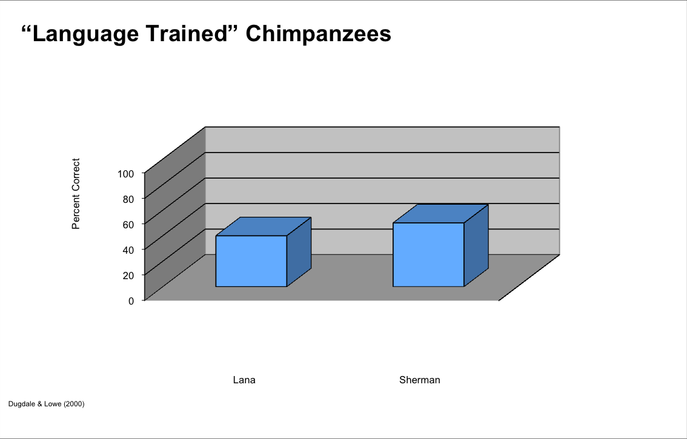
Not Yet Shown in Non-Humans

Slide 21
Derived Relations Build Out into Networks
1. Mutual Relations
salivation
smooth
sweet
crunchy
red
Apple
juicy
Jabuka
3. With Changed Functions
2. In Networks
salivation
sweet
smooth
Jabuka
crunchy
red
juicy
Notes:
Jabuka is Croatian for Apple

Slide 22
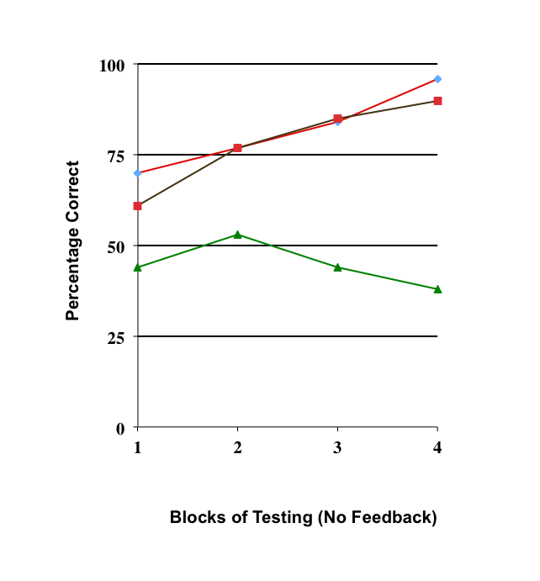
Without That, Normal Language Does Not Occur
Normal
LD: Receptive
Chance
LD: No receptive
Devany, Hayes, & Nelson (1986)

Slide 23
We Believe This is the Core of Symbolic Thought, but How Did it Evolve?
My Argument: Cooperation Came First

Slide 24


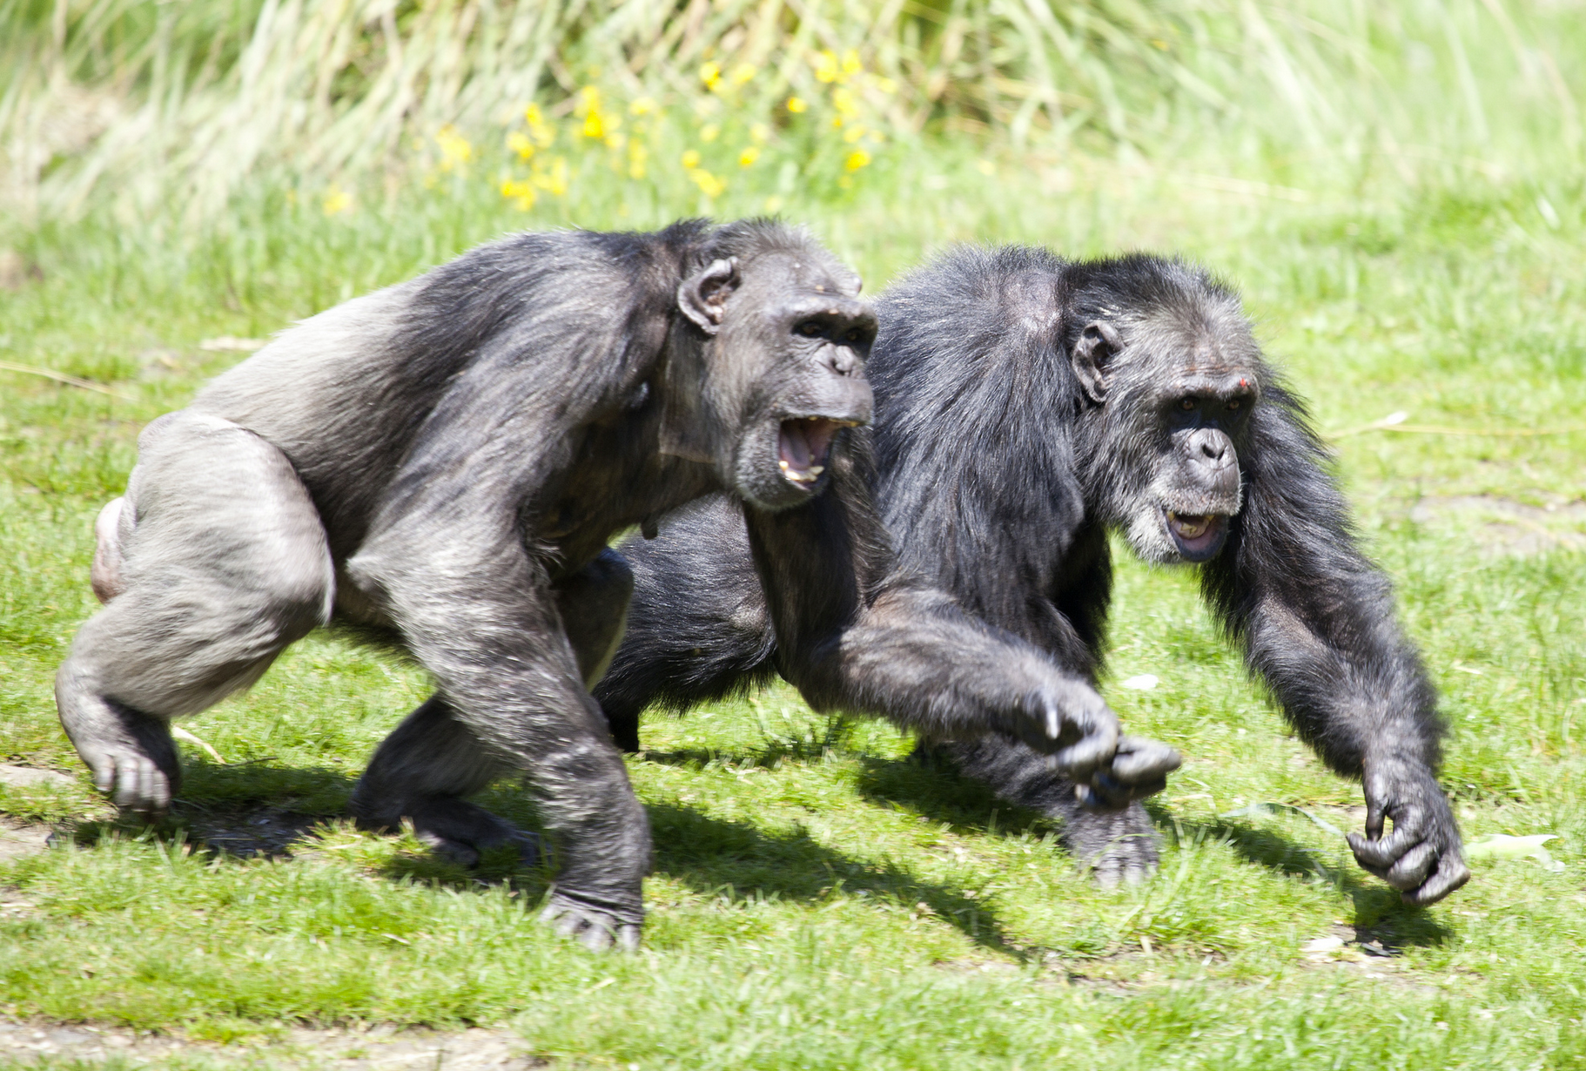
Carrying

Slide 25
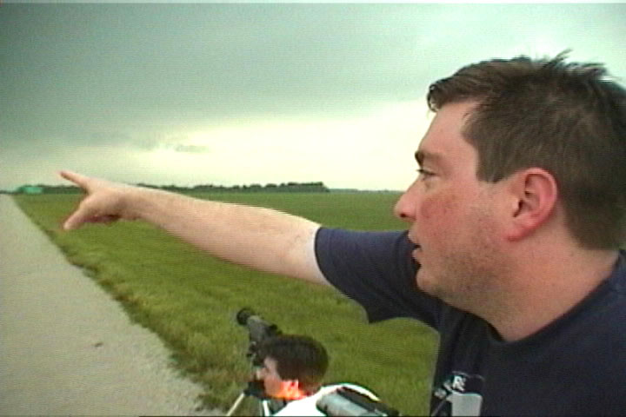
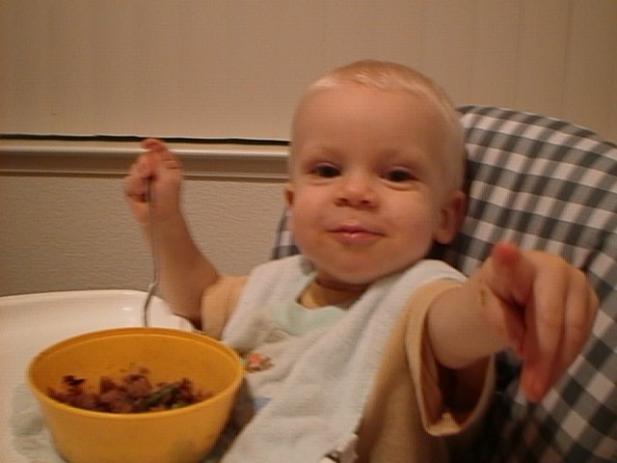
Joint Attention and
Social Referencing

Slide 26
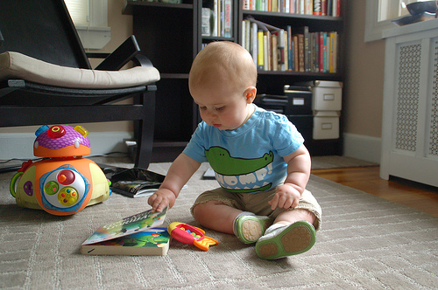
Understanding of Intentionality
Notes:
My argument … it is human consciousness itself … which forms the link between compassion and self-acceptance

Slide 27

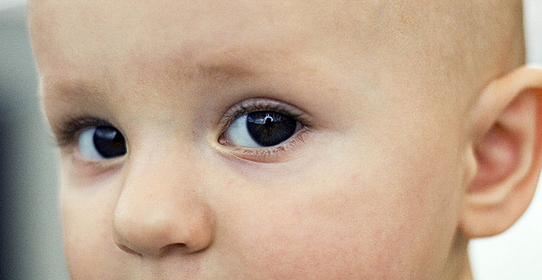
We Are Physically
Attuned to Intentionality

Slide 28
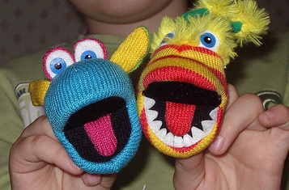
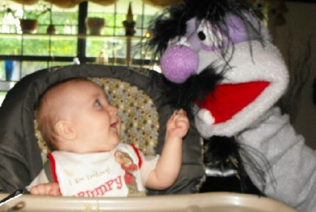
Rewarding Cooperation
Notes:
My argument … it is human consciousness itself … which forms the link between compassion and self-acceptance

Slide 29
Let Me
Show You

Slide 30
Symbolic Thought Began as a Form of Social Cooperation and only Then Was Internalized And Made Efficient Genetically
Notes:
My argument … it is human consciousness itself … which forms the link between compassion and self-acceptance

Slide 31


This Simple Perspective Taking Extended to all Cognitive Relations
Learn
<
Derive
>
reinforcer
Reinforcer
New Functions:
If
then

Slide 32
But it Ultimately Extended Even to Perspective Taking Itself

Slide 33
Perspective Taking Skills
YOU
HERE
NOW
I
THERE
THEN

Slide 34
Contextual Self
The Fromness of Consciousness

Slide 35
Consciousness is Social, Extending Across Time, Place, and Person

Slide 36
What Research Tells Us
Perspective taking is central to social and psychological functioning
Crucial to empathy and compassion (large effect sizes, r = ~ .5)
Needed for self-acceptance and self-compassion (moderate to large effect sizes, r = ~ .45)
Together these three processes form a psychosocial system of functional connectedness
Notes:
36
36

Slide 37
The Three Elements of Flexible Connectedness
1. Perspective Taking
2. Empathy
3. Psychological openness
Notes:
The Woman with the shopping cart

Slide 38
Vilardaga, Estévez, Levin & Hayes, 2012
Caring About Being With Others
Perspective
Taking
Psychological
Openness
Empathy
✔
✔
✔
-
Accounts for 26% of Social Anhedonia
Notes:
Social anhedonia correlated with social adjustment and psychosis
Why would people not care about being with others?
Well it hurts. So what, well Experiential avoidance. But then why does it hurt?
Well empathy. But why? Well you can take the perspective of others.
So you get a model like this

Slide 39
Prejudice Toward Others
Perspective
Taking
Psychological
Opennes
Empathy
✔
✔
✔
-
Accounts for ~40% of Poly-Prejudice
Notes:
Social anhedonia correlated with social adjustment and psychosis
Why would people not care about being with others?
Well it hurts. So what, well Experiential avoidance. But then why does it hurt?
Well empathy. But why? Well you can take the perspective of others.
So you get a model like this

Slide 40
Three Senses of Self:
As Conceptualized;
As a Process of Knowing;
As the Fromness of Awareness

Slide 41
What is a Human Mind?
A collection of biological and cultural capacities that allow us to know and to learn through direct experience and symbolic derivation

Slide 42
Why is it So Hard?
We can experience pain anytime, anywhere
Our judgmental abilities overwhelm us and create the illusion of aloneness

Slide 43
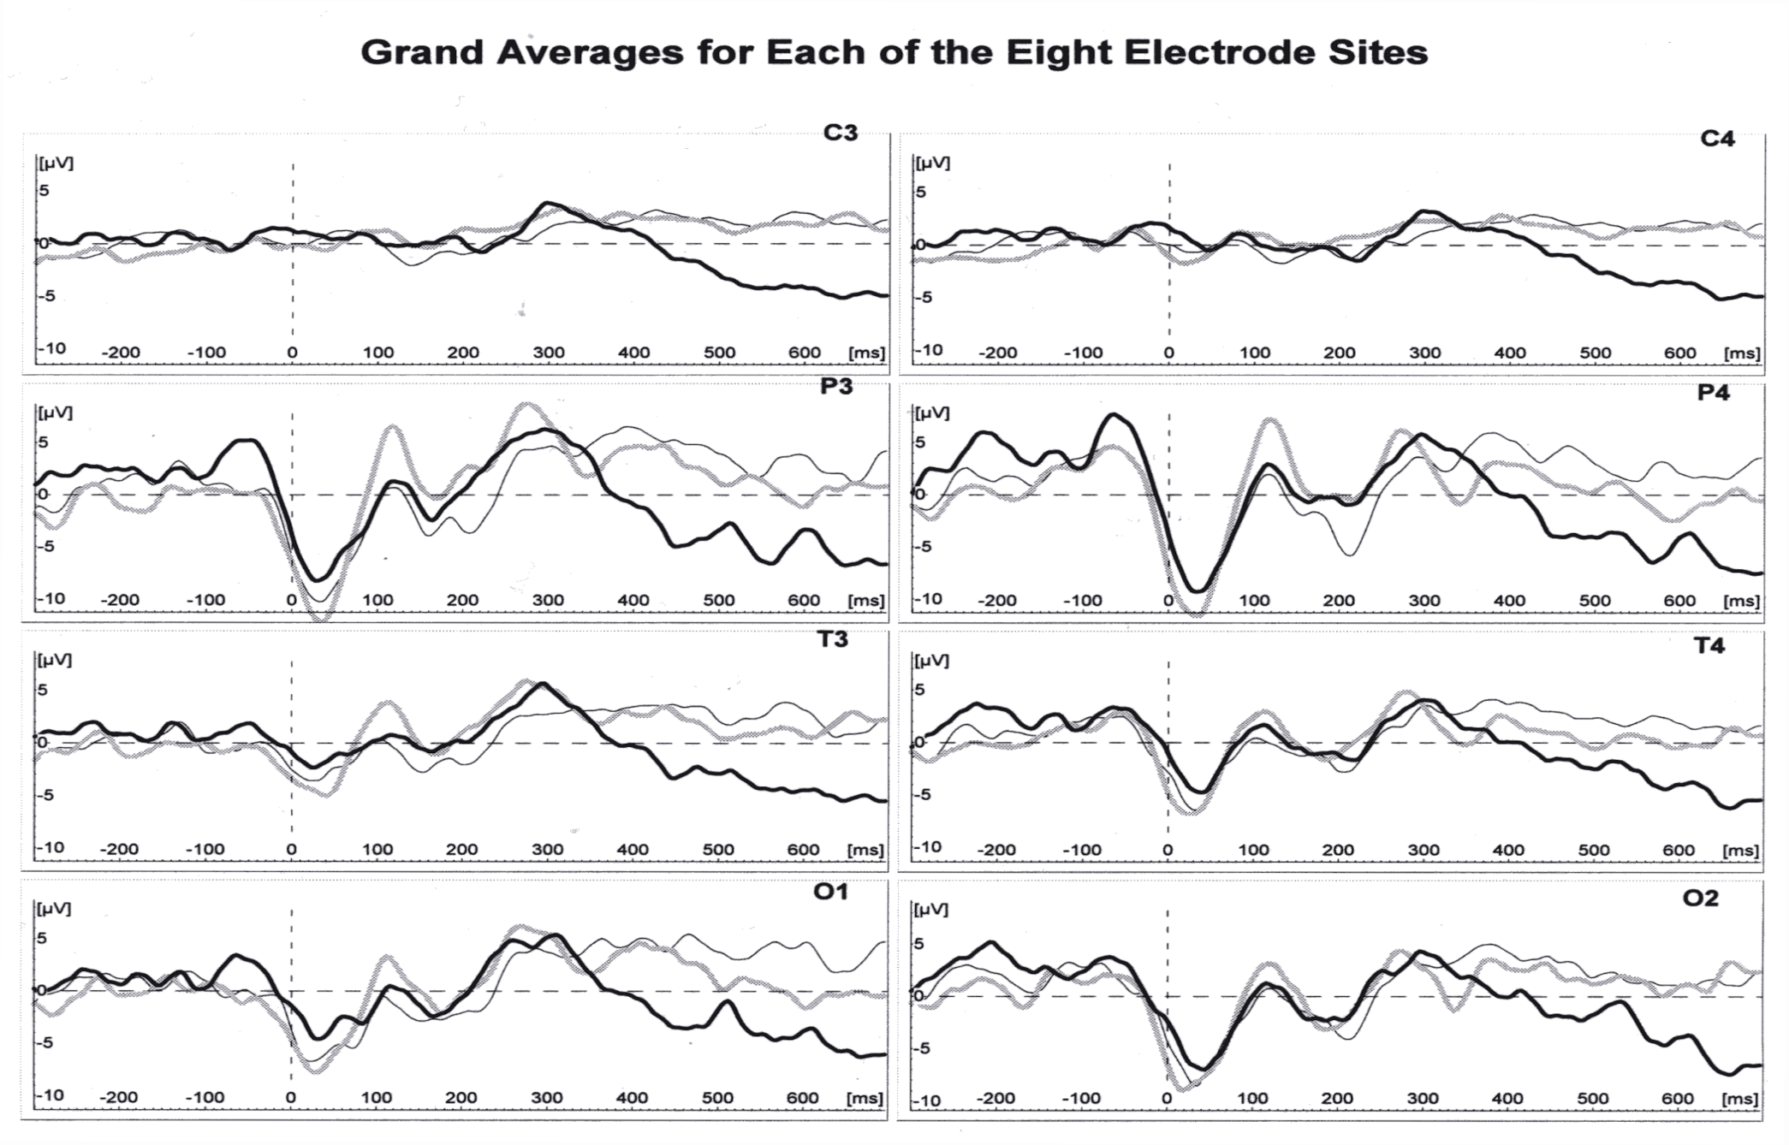
Derived Relations Look Like Trained Ones
Left Hemisphere
Right Hemisphere
Directly Trained and Derived Relations
Non-Equivalent Stimuli
Directly Trained
Equivalent Stimuli
Barnes-Holmes, et al. (2006)

Slide 44
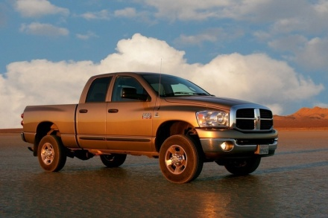
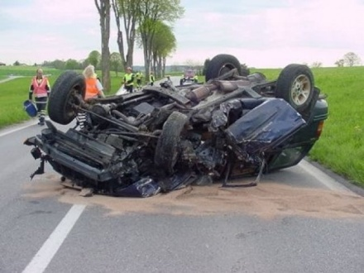
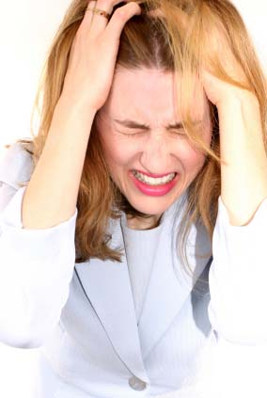
Through human cognition we can bring aversive events into any setting
“Car”
CAR

Slide 45


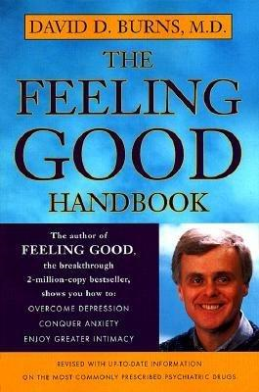
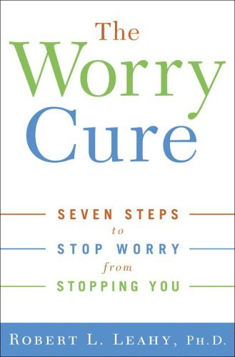
LOOK AT WHAT WE SELL

Slide 46
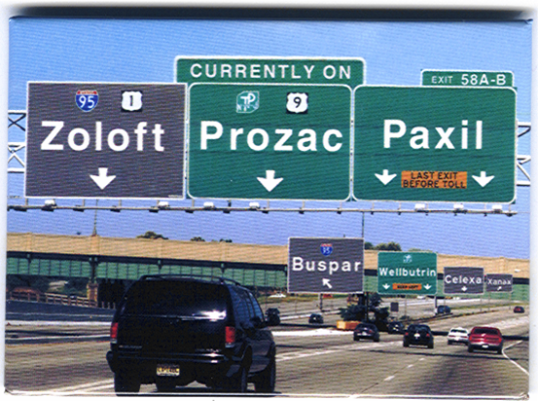

Slide 47
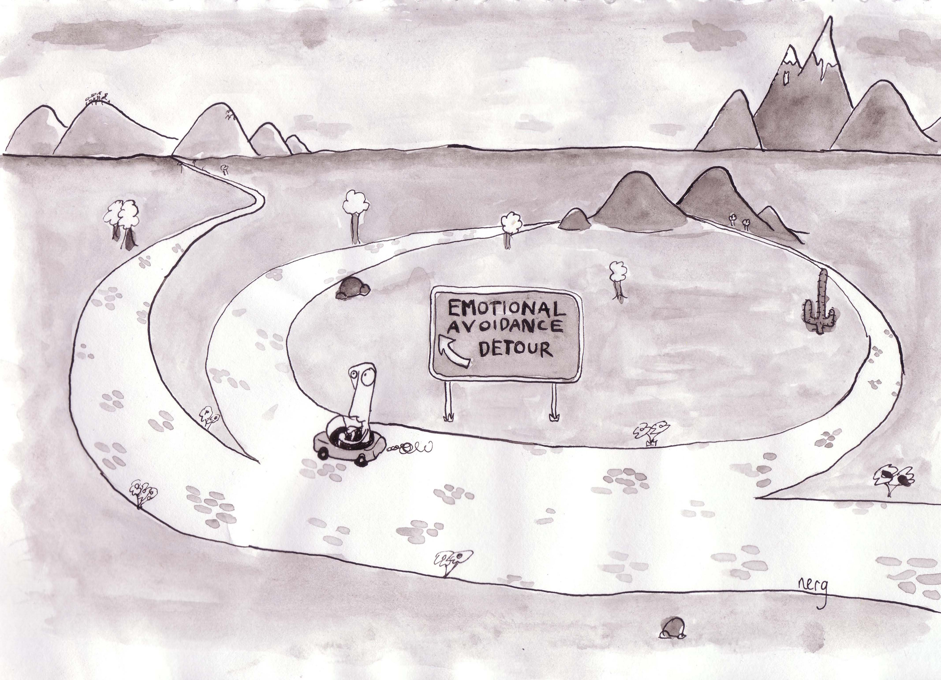
Notes:
what can happen when we let the monster dictate how we live. Nobody wants to spend their time and energy on this roundabout, but it is so easy to do. In fact, this cartoon doesn’t even show how crowded this round about really is?

Slide 48
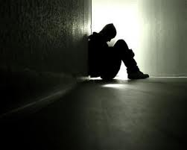
The Illusion of Aloneness
I’m ___

Slide 49
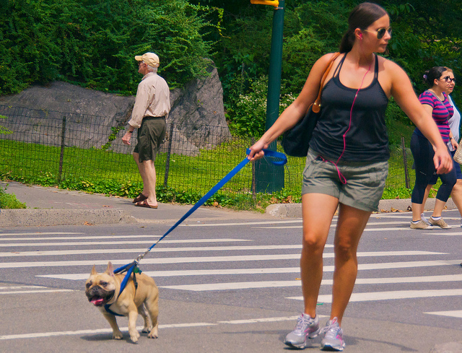
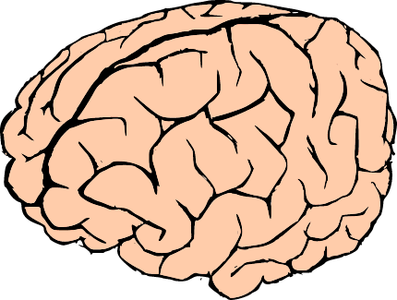
What Can We Do About It?
Learn to Put the Mind on a Leash

Slide 50

Promoting Emotional Variation

Slide 51
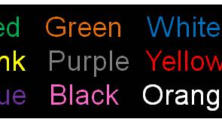
And Cognitive Flexibility

Slide 52
Open
An ACT Model of Treatment

Slide 53

To Fit Variation to Context We Need Flexible Attention to the Moment Inside and Out

Slide 54
An ACT Model of Treatment
Aware

Slide 55
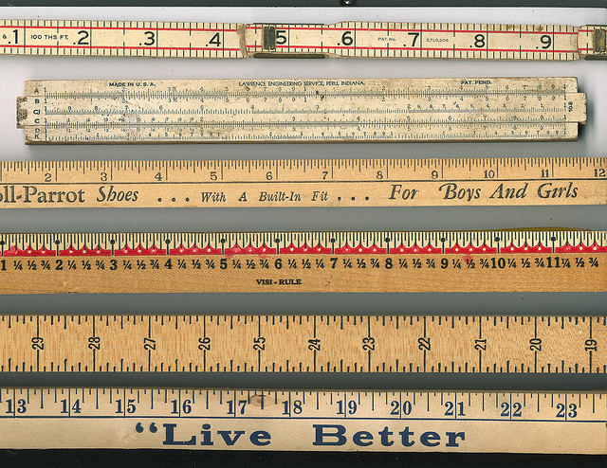
Picking the Selection Criterion

Slide 56
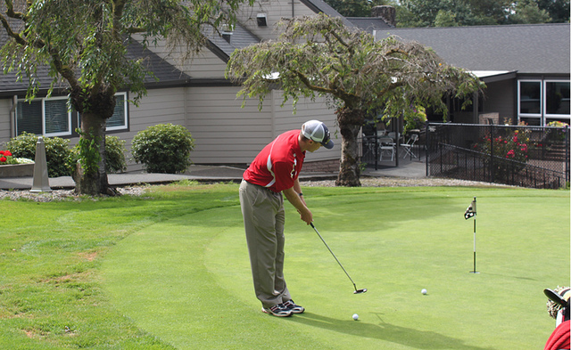
And Retaining Effective Action by Practice

Slide 57
Actively Engaged
An ACT Model of Treatment

Slide 58
What Can We Do About it?
From the WE of Awareness we Can Learn to Open Up, to Be Here, and to Care and Live on Purpose as Part of the Community.

Slide 59
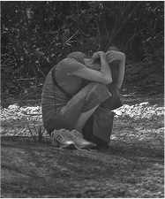

Perspective Taking Helps Us
Come into the Now, and
Let Go
Engage Life

Slide 60
The Rx Model
An ACT Model of Treatment/Health
Psychological Flexibility

Slide 61
Correlational and Longitudinal
Psychological flexibility predicts most forms of psychopathology and quality of life in children, adults, and the elderly
Mediates the effects of many is not most key targeted processes in evidence based treatment: e.g., anxiety sensitivity, cognitive reappraisial and so on

Slide 62
Example
Spinhoven, Drost, de Rooij, van Hemert & Penninx, 2014, BT
2,316 adults assessed with diagnostic interviews and a psychological flexibility measure over a four year period
Flexibility predicted anxiety and depressive disorders two years later, beyond baseline values of these disorders.
Flexibility mediated over 4 years the growth and clustering of disorders

Slide 63
Controlled Studies on an Amazing Range of Areas
work stress, pain, smoking, anxiety, depression, diabetes management, substance use, stigma toward substance users in recovery, adjustment to cancer, epilepsy, coping with psychosis, borderline personality disorder, trichotillomania, obsessive-compulsive disorder, marijuana dependence, skin picking, racial prejudice, prejudice toward people with mental health problems, whiplash associated disorders, generalized anxiety disorder, chronic pediatric pain, weight-maintenance and self-stigma, exercise, chess playing, tinnitus, eating disorders, clinicians’ adoption of evidence-based pharmacotherapy, and training clinicians in psychotherapy methods other than ACT.

Slide 64
Notes:
If applied folks do not have the basic stuff they need, they need to develop it
If basic folks are frustrated at the application of their ideas, they need to create them
No more farming it out
Especially given our goal

Slide 65
Pediatric Chronic Pain
Wicksell, Melin, Lekander, & Olsson, Pain, 2009
32 patients w/ longstanding pediatric pain
25 female; ~ 15 y o, 32 mo pain duration
Randomly assigned to ACT or multidiscipinary Rx & medication (MDT). 2 drop outs.
Pre / post / 3.5mo f-up / 6.5 mo f-up
ACT = 12 session; MDT = 23

Slide 66
Pain Interference
6
MDT
4
Pain Interference (1-10)
ACT
2
Pre
Post
3.5 mo
6.5 mo

Slide 67
Health Behavior Change Among Colorectal Cancer Survivors
Hawkes et al., 2013
410 colorectal cancer survivors randomly assigned either to telephone ACT or to usual care
11 phone calls over six months
6 and 12 month follow up
Targets: physical activity, diet, weight, smoking, alcohol
At one year: lower fat intake, lower BMI, higher exercise
Notes:
Previous research has reported elevated levels of psychological distress (e.g. Stanton, et al, 2000), depression (e.g., Andersen & Golden-Kreutz, 2001), and anxiety (e.g. Epping-Jordon, et al, 1999) in various oncology populations. However, only one study has attempted to differentiate the prevalence of psychological distress across cancer sites. Based upon results of that single project, 29.6% of the individuals with gynecological cancers report psychological distress (Zabora, Brintzenofeszoc, Curbow, Hooker, & Piantadosi, 2001).
The results from this sample were consistent with those previous findings of general levels of psychological distress. Remember, these patients were not chosen for participation because of their distress, but merely due to their diagnosis. That is a issue that will be address in future reseach.
Based on BDI of 22-37
BAI of 22-37, and POMS above 55

Slide 68
Moderate + Vigorous Exercise
90
ACT
80
70
Minutes Per Weeks
60
TAU
50
Pre
6 mo
1 yr

Slide 69
Post Traumatic Growth
65
ACT
60
Mean Self-Reported Score
55
TAU
50
Pre
6 mo
1 yr

Slide 70
But What About Thriving?
Bohlmeijer, Lamers, & Fledderus, 2015
Study done with 376 depressed people and an ACT book (Living Life to the Fullest)
Large decrease in depression;
Flourishing:
  emotional well-being (positive affect, happiness, and satisfaction with life);
  psychological well-being (autonomy, mastery, growth, purpose, self-acceptance);
  social well-being (social acceptance, actualization, contribution, coherence, and integration).
Notes:
Previous research has reported elevated levels of psychological distress (e.g. Stanton, et al, 2000), depression (e.g., Andersen & Golden-Kreutz, 2001), and anxiety (e.g. Epping-Jordon, et al, 1999) in various oncology populations. However, only one study has attempted to differentiate the prevalence of psychological distress across cancer sites. Based upon results of that single project, 29.6% of the individuals with gynecological cancers report psychological distress (Zabora, Brintzenofeszoc, Curbow, Hooker, & Piantadosi, 2001).
The results from this sample were consistent with those previous findings of general levels of psychological distress. Remember, these patients were not chosen for participation because of their distress, but merely due to their diagnosis. That is a issue that will be address in future reseach.
Based on BDI of 22-37
BAI of 22-37, and POMS above 55

Slide 71
Percent Newly “Flourishing” w/
Majority of Areas Very High
Bohlmeijer, Lamers, & Fledderus, 2015
25
Control
Control
20
15
10
ACT
ACT
5
0
% Newly Flourishing
Post
% Newly Flourishing
F Up
Notes:
Previous research has reported elevated levels of psychological distress (e.g. Stanton, et al, 2000), depression (e.g., Andersen & Golden-Kreutz, 2001), and anxiety (e.g. Epping-Jordon, et al, 1999) in various oncology populations. However, only one study has attempted to differentiate the prevalence of psychological distress across cancer sites. Based upon results of that single project, 29.6% of the individuals with gynecological cancers report psychological distress (Zabora, Brintzenofeszoc, Curbow, Hooker, & Piantadosi, 2001).
The results from this sample were consistent with those previous findings of general levels of psychological distress. Remember, these patients were not chosen for participation because of their distress, but merely due to their diagnosis. That is a issue that will be address in future reseach.
Based on BDI of 22-37
BAI of 22-37, and POMS above 55

Slide 72
Experiential Avoidance and MH Stigma
Masuda et al., 2007
RCT comparing education focused on prevalence and costs of stigma toward mental health problems, and accurate information about them
ACT focused on defusion from and mindfulness of prejudicial thoughts, acceptance of difficult prejudicial feelings, and values

Slide 73
ACT for Mental Health Stigma
Education
Hi EA
-25
-30
Lo EA
ACT
Average MH Stigma Score
-35
-40
Pre
Post
F-Up

Slide 74
ACT for Shame
Luoma et al., JCCP
134 participants in a 28 day in-patient drug program
Randomly assigned in waves to receive treatment as usual or that plus a 6-hour ACT group focused particularly on self-stigma and shame
Thus the total difference in the program is minimal – about 3-5% of the treatment hours
71% available at follow up

Slide 75
Shame Outcomes: Better for TAU
110
ACT
105
100
Average Score
95
TAU
90
85
Pre
Post

Slide 76
Quality of Life Outcomes: Better for TAU
80
78
76
TAU
Average Score
74
72
ACT
70
Pre
Post

Slide 77
Substance Use Outcomes
6
5
TAU
4
Days / Month Using Drugs or Alcohol
3
2
1
ACT
0
1 Month
Follow Up

Slide 78
Group ACT for Shame
But now let’s look at what happens through the rest of follow up

Slide 79
Substance Use Outcomes
6
5
TAU
4
Days / Month Using Drugs or Alcohol
3
2
d = 1.21
1
ACT
0
1 Month
2 Month
3 Month
Follow Up

Slide 80
Shame Outcomes
r with use
at follow up = ns
110
ACT
105
100
Average Score
r with use
at follow up =
-.51 (p < .01)
95
90
TAU
85
Pre
Post
3 Mo F-Up

Slide 81
Quality of Life Outcomes
80
ACT
78
76
TAU
Average Score
74
72
70
Pre
Post
3 Mo F-Up

Slide 82
One Year ITT Follow Up adjusting for time to prev hospitalization and length of hospitalization

Slide 83
Reaching the Need:
ACT / PROSOCIAL in Sierra Leone
6 million people in Sierra Leone: 1 psychologist; 1 retired psychiatrist
2010 Beate Ebert starts a program in Freetown
ABCS brought 5 health workers to World Con (2010, 2012)
ACT trainers flew into Sierra Leone (2011-present)
Work with indigenous workers, in a “train the trainers” model

Slide 84
Desperate Level of Need

Slide 85
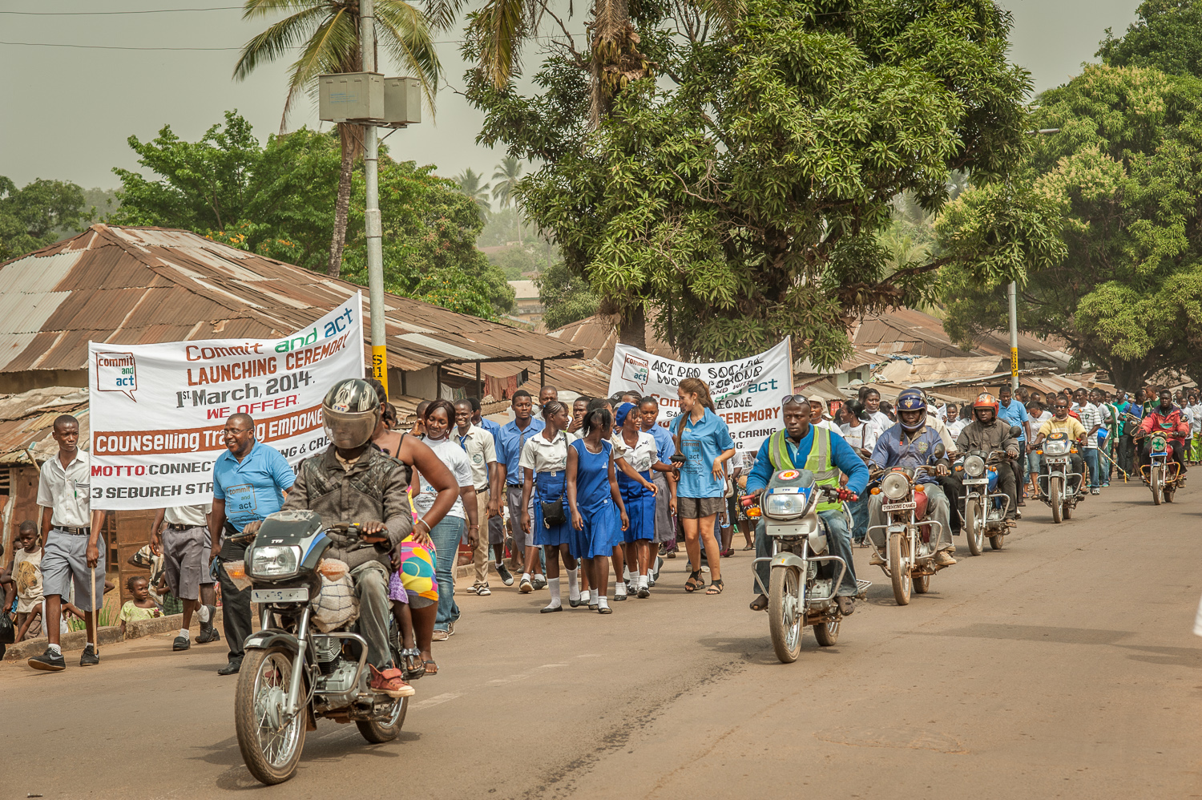
In 2014 a New Clinic in Bo

Slide 86
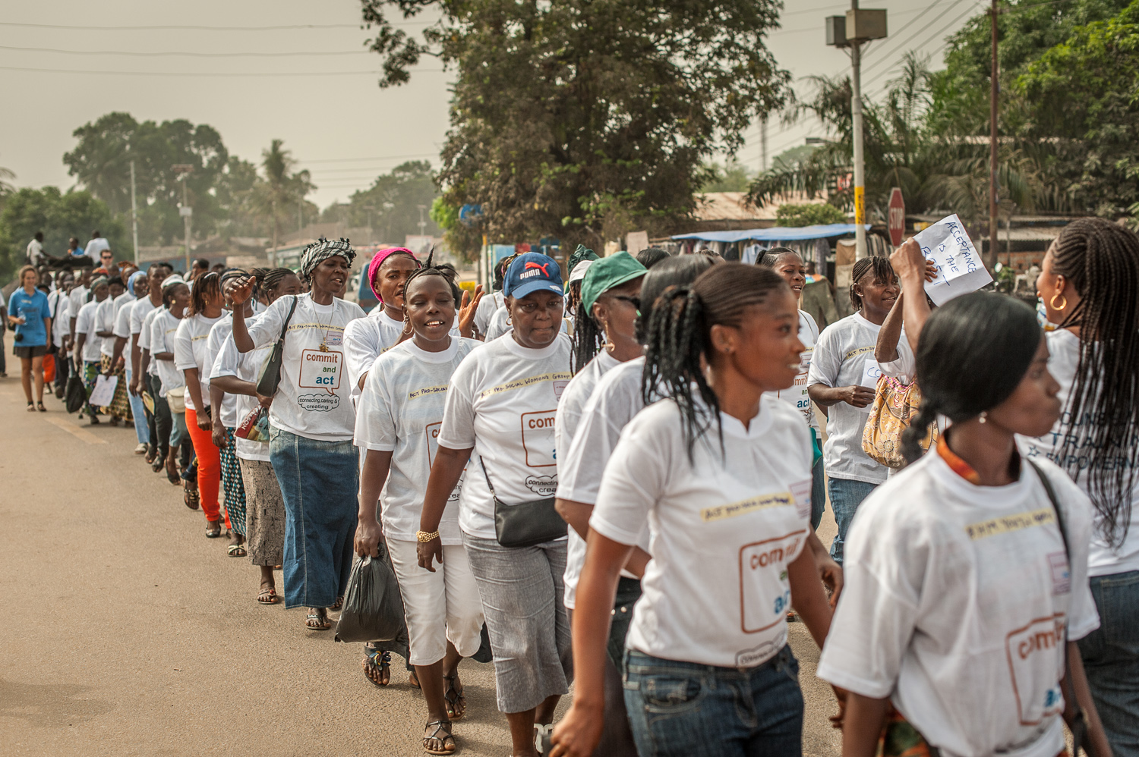
New Clinic in Bo

Slide 87
Now Here Comes Ebola and the Clinic Director is Named the Bo Ebola Response Director
The country is isolated; the aid workers leave;
Thousands die
Hannah is named director for Ebola prevention in her district by the Ministry of Health and Sanitation
Her approach: involve the people directly in ACT / PROSOCIAL based workshops

Slide 88
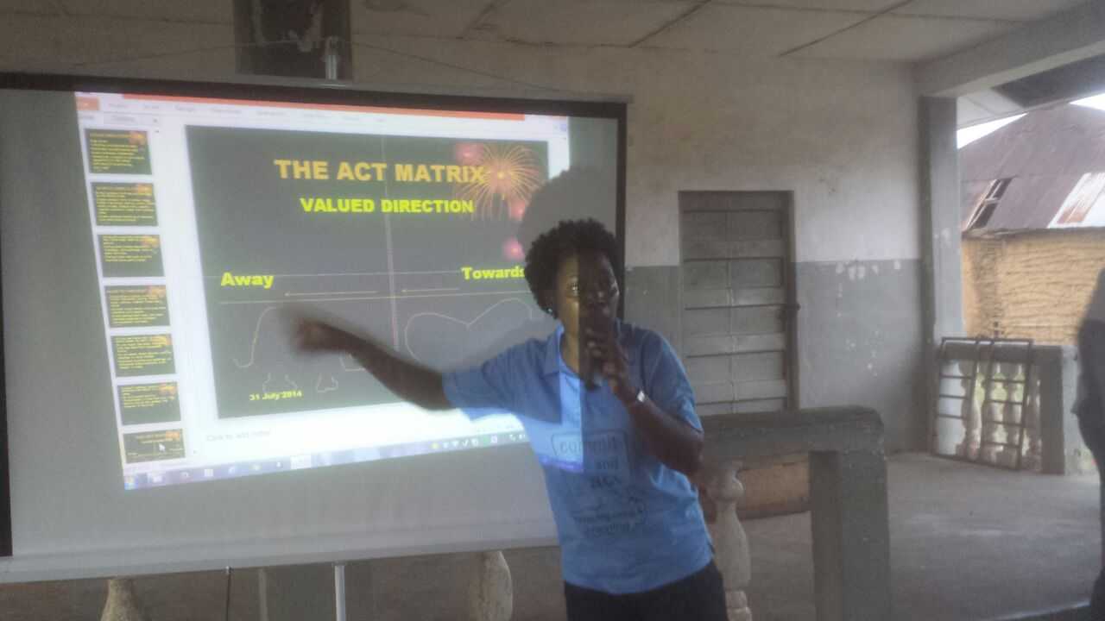
Using the ACT / PROSOCIAL
Hannah Bockarie

Slide 89
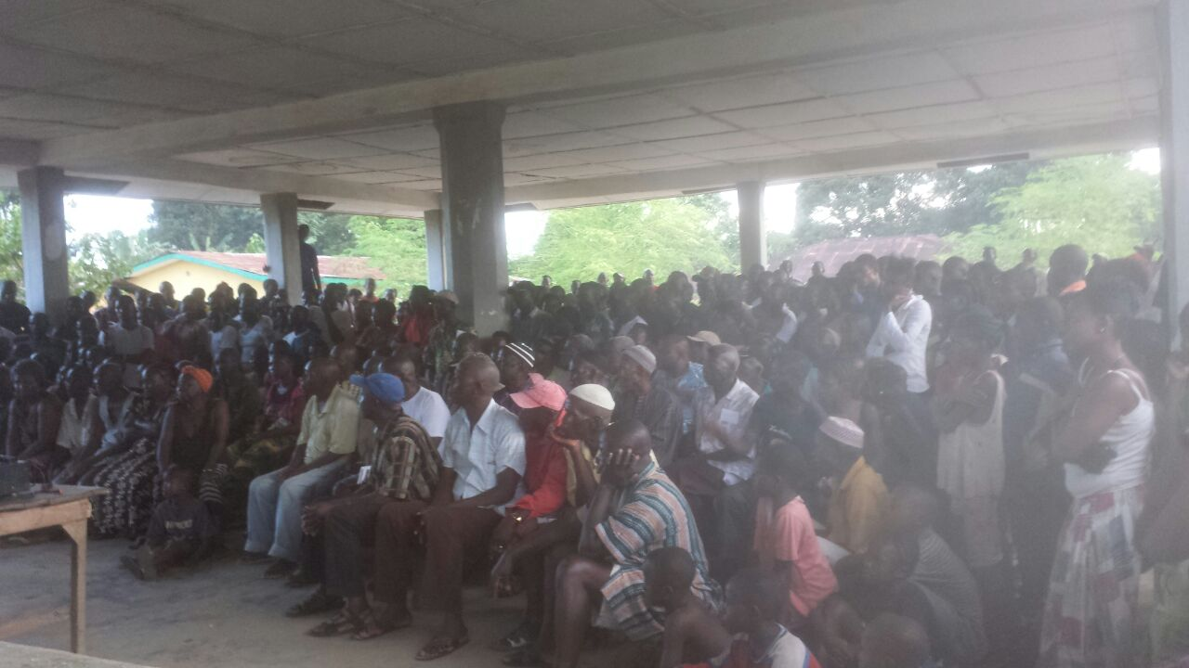
With An Entire Community

Slide 90

Example of Solutions
Example of their solutions:
You must kiss the body of the dead before burial.
What to do?
Kiss and bury a banana trunk
Bo infection infection increase slows

